Slide 1
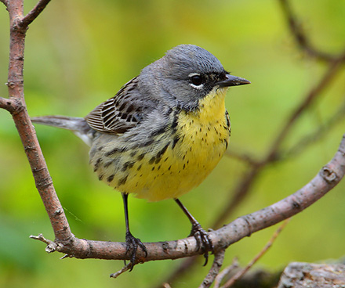
The Endangered Kirtland Warbler
By Brendan malloy

Slide 2
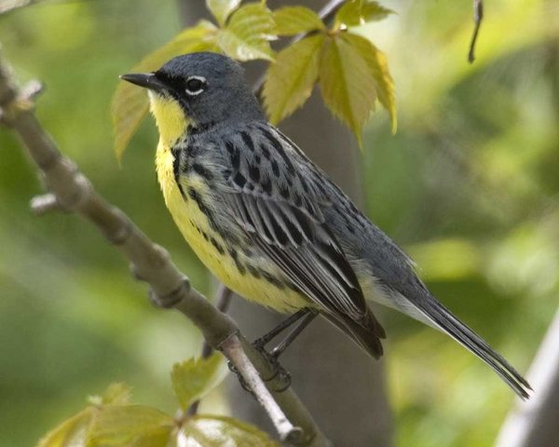
What is a Kirtland’s Warbler?
A lot of people don’t know what a Kirtland Warbler is, well I can tell you. First of all a Warbler is a kind of bird, so obviously the Kirtland Warbler is a bird. But not only is it a bird, it is a bird that could go extinct! The Kirtland’s Warbler is also known as the Jack Pine Warbler or American Warblemaster.

Slide 3
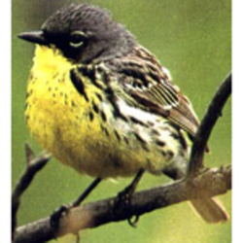
Why it is endangered?
Lack of young jack pine forest habitat, witch is where they live.
Brown Headed Cow Bird eats Kirtland’s Warbler.
ENDANGERED

Slide 4
What is being done to help the Kirtland’s Warbler?
a recovery plan was made in 1976 and remade in 1985 to help increase the population of the Kirtland’s Warbler. This plan helps to keep and grow their nesting habitat. It includes 5 objectives :
Develop forests of jack pine trees for the Kirtland’s Warbler to nest
Protect the Kirtland’s Warbler
Reduce anything harming the Kirtland’s Warbler
Monitor it’s population
Develop plans to prevent extinction

Slide 5
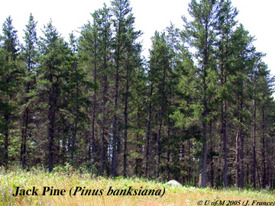
How can you help the Kirtland’s Warbler?
One easy way to help Kirtland Warblers is to help plant jack pine trees, find out how to manage the forest near you. Many forest managers have made special areas for this bird so it can nest. You can also join conservation organization that helps protect the Kirtland’s Warbler. Also you can write your local, state and federal officials to tell them how you feel about the Kirtland’s Warbler so they will help protect it. Lastly, another way you can help is if you see one, make sure it is safe and in no harm and if it is being harmed try to help the bird in any way possible

Slide 6
How has this effected the ecosystem?
Well if the Kirtland’s Warbler went extinct the brown headed cow bird [the predator] could also go extinct because it won’t have any food to eat, along with the things that eat the cowbird, along with the things that eat the things that eat the cowbird,along with the things that eat the things that eat the things that eat the cowbird?
The jack pine trees provide valuable wood products and jobs.
Also, its story can help teach everyone about birds, nature, how humans are impacting the environment and how to help endangered species.
Lastly, the Kirkland’s Warbler is a natural wonder and adds beauty to the world.

Slide 7
THE END!
I learned a lot studying the Kirtland’s Warbler and I hope someday I can see one!
Hope you liked it ;P

